Slide 1
Secure Boot
2024.12

Slide 2

Why Secure Boot
Protection Against Malware
Defense Against Unauthorized Firmware
Compliance and Certification Requirement
Prevention of Firmware Attacks

Slide 3
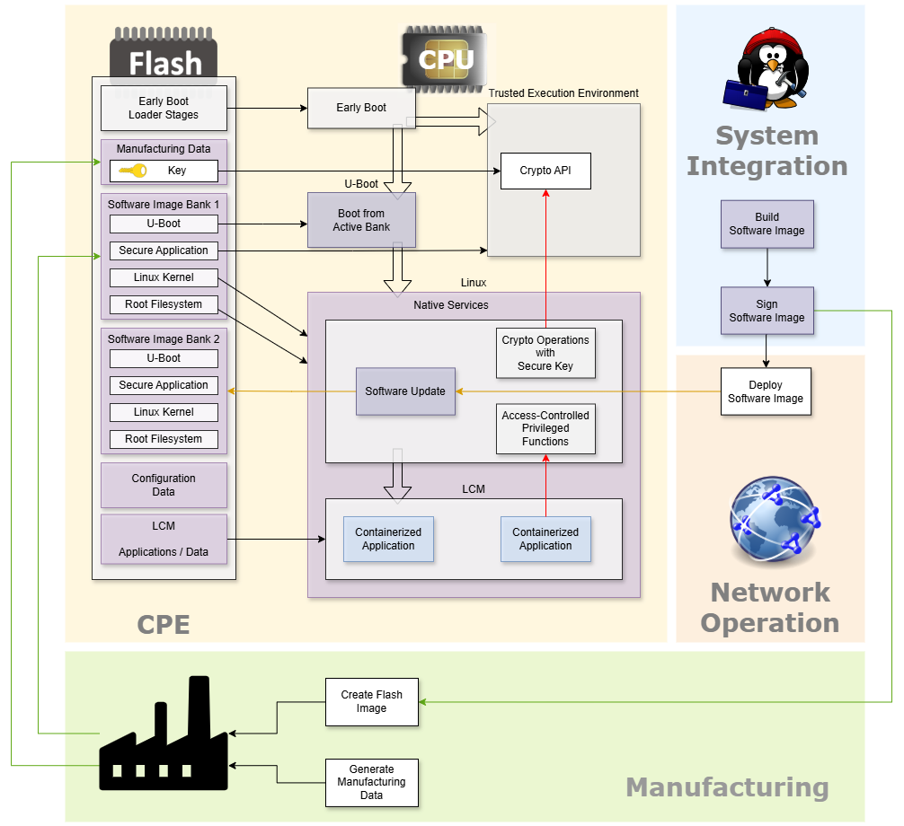
prpl Secure Boot

Slide 4
Secure Boot
Abbreviations and Acronyms
BL1 | First stage bootloader, which is stored in the read-only memory (ROM) of the SoC. It initialize some hardware components and load BL2 into RAM from non-volatile storage.
BL2 | First bootloader element that is stored in non-volatile memory. It sets up DRAM, MMU and Trustzone protection. It loads Multiple BL3-x stage images from non-volatile to memory
BL3-1 | The EL3 firmware, is the first component of ATF that runs on a system after power-up or reset. It is executed in “Exception Level 3” (EL3) – highest privilege level on ARM. It provides secure runtime services to non trusted OS such as Linux
BL3-2 | The Secure monitor, is a component of ATF that provides a trusted execution environment (TEE) for running secure applications and services.
BL3-3 | U-Boot, is responsible for initializing the hardware and loading the operating system or other software on an embedded system.
Notes:
The following is a common usage model for the exception levels:
EL0Applications.
EL1OS kernels and associated functions that are typically described as privileged.
EL2Hypervisor.
EL3Secure monitor.

Slide 5
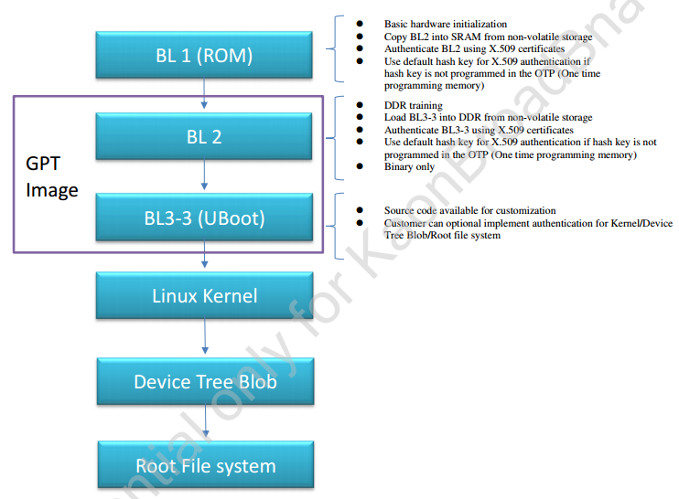
Secure Boot
Cortina Secure boot Flow

Slide 6
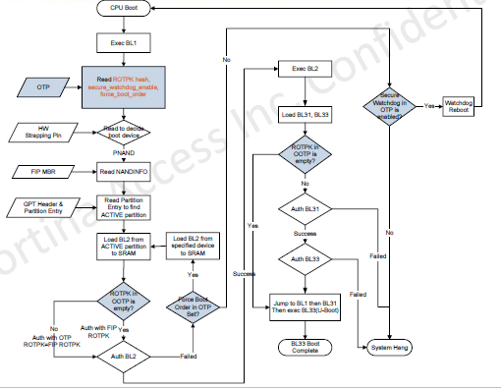
Secure Boot
Secure boot algorithm

Slide 7
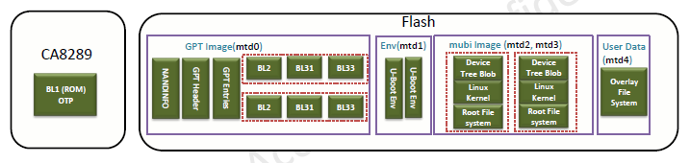
Secure Boot
Image partitions

Slide 8
Secure Boot
Cortina Secure Boot components:
ATF: ARM Trusted Firmware which provides trusted secure boot and a small trusted runtime
Cortina Multiboot: responsible for managing the selection of target devices/partitions during system boot up and fail with authentication
Cortina Dual Images: dual Linux kernel + rootfs partitions and partition selection mechanism
U-Boot Verified Boot: a feature allowing for the verification of a kernel and other images

Slide 9
ATF – ARM Trusted Firmware
ARM Trusted Firmware is a reference implementation of secure world software for Arm A-Profile architectures (Armv8-A and Armv7-A). It provides a suitable starting point for productization of secure world boot and runtime firmware
The implementation of ATF spreads from CPU ROM code to bootloader binaries. Cortina SDK provides the framework to generate firmware in accordance with ATF’s requirement
Customization:
Provide keys to sign/authenticate images
Write hash_of_ROT_public_key to every CPU’s OTP

Slide 10
ATF – ARM Trusted Firmware
Generate Public Key
Generate RSA 2048 bit (PEM) private key (i.e., ROTPK):
openssl genrsa -out venus_rotprivk_rsa.pem 2048
Generate RSA 2048 bit public key (DER) from private key (PEM):
openssl rsa -in venus_rotprivk_rsa.pem -inform PEM -pubout -outform DER -out venus_rotpk_rsa.der
SHA256 (binary) hash of public key (DER):
openssl rsa -pubin -inform DER -in venus_rotpk_rsa.der -outform der | openssl dgst -sha256 -binary > venus_rotpk_rsa_sha256.bin
Copy the private key to direction: feed_kaon/targets/venus/image/keys

Slide 11
ATF – ARM Trusted Firmware
OTP Fields
The OTP(One-Time-Programmable Memory) act as a storage of bootstrap encryption key, authentication methods and boot devices prioritization.
Fields in use:
hash_of_ROT_public_key: Start Position: bit 384, Length: 256 bits
secure_watchdog_enable: Start Position: bit 1119, Length: 1 bits
forced_boot_order: Start Position: bit 1152, Length: 32 bits

Slide 12
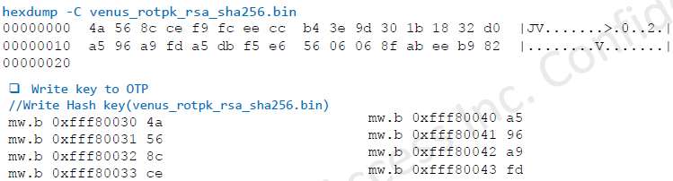
ATF – ARM Trusted Firmware
Write Public Key to OTP (CA8289)
Turn off OTP register protection
mw.l 0xf43201a0 0x7bffff
Turn off local OTP protection bits
mw.l 0xfff8080c 0x0
Write public key to OTP (0xfff80030)
Turn protection back on
mw.l 0xfff8080c 0x3
Turn back on OTP register protection
mw.l 0xf43201a0 0x3fffff

Slide 13
Cortina Multi boot
Contains 2 parts:
OTP fields including hash_of_ROT_public_key, secure_watchdog_enable and forced_boot_order
FIP(Firmware Image Package) encapsulation which contains partition attribute active/standby
Responsible for managing the selection of target partitions during system boot up. It currently supports Cortina Firmware Image Package (FIP) partitions which are encapsulated by a standard GUID Partition Table(GPT)
Customization:
Write secure_watchdog_enable and forced_boot_order to every CPU’s OTP

Slide 14
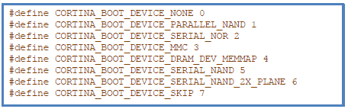
Cortina Multi boot
Forced_boot_order fields:
Primary boot device is normally selected using HW Strapping pin configuration. If primary boot device fails to boot, system attempt to boot from a different partition (same physical device or different physical device). This may be accomplished by the subsequent desired boot order – forced_boot_order
Contains 32 bit: 8 boot tuples with 4 bits in each one.
High 3 bits specify the physical boot device ID (0x0 and 0x7 are reserved)
Lower bit specifies status: ACTIVE/STANDBY partitions

Slide 15
Cortina Dual Images
Contains 4 parts:
U-Boot environment variables which record the status and flags of images
Dual images generated by Cortina SDK
U-Boot function for image selection
ca-upgrade for image upgrade in Linux user space
Customization:
Customized application for setting images status and selecting iamges to boot according to the function result of ca.upgrade OMCI upgrade, U-Boot Verified Boot and all the other applications that manipulated images.

Slide 16
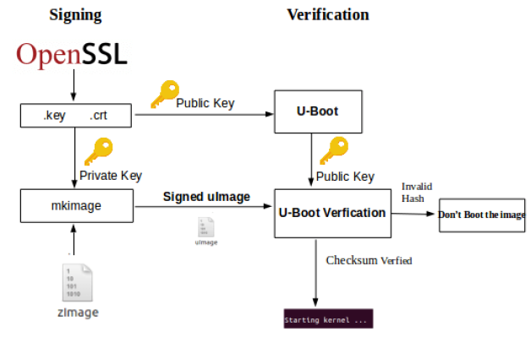
U-Boot Verified Boot
U-Boot verified boot relies on two familiar technologies cryptographic hashing(e.g SHA1) and public key cryptography(i.e RSA)

Slide 17
U-Boot Verified Boot
Customization:
Provide Keys to sign/authenticate images
Modify and uncomment the options in u-boot configuration to enable feature
feed_kaon/boot/u-boot-pg249x/src/configs/kaon-pg1892g-mmc_defconfig
Modify the U-Boot environment variable to enable this feature
feed_kaon/boot/u-boot-pg249x/files/uboot-env-kaon-pg1892g-mmc.txt
image_type=image ➔ non-FIT image
image_type=fit ➔ FIT image

Slide 18
Secure Boot

Slide 19
THANK YOU

